Slide 1
Azure Cosmos DB IoT Solution Accelerator
<Speaker>
<date>

Slide 2

Introduction to NoSQL: A brief history of databases

Slide 3
Introduction to NoSQL
A brief history of databases

Slide 4
The
Data Singularity……
Schema
The Relational Database.
Relational
Data Integrity
ACID
Serializable

Slide 5
The expanding
Data Universe……
Variety
Velocity
Volume
Conformity
Data Structure Spectrum
Flexibility
Schema-on-write
Schema-on-read
Relational
Column-family
Document
Graph
Key-value
File System
Data Integrity
Data Persistence Spectrum
Performance
Isolation
Transactions (ACID)
Concurrency
Serializable
Snapshot Isolation
Repeatable Read
Read Committed
Read Uncommitted
Replication (CAP Theorem)
Availability
Consistency
Strong
Bounded Staleness
Session
Consistent Pre-fix
Eventual
= supported in Cosmos DB

Slide 6

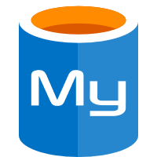
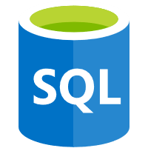



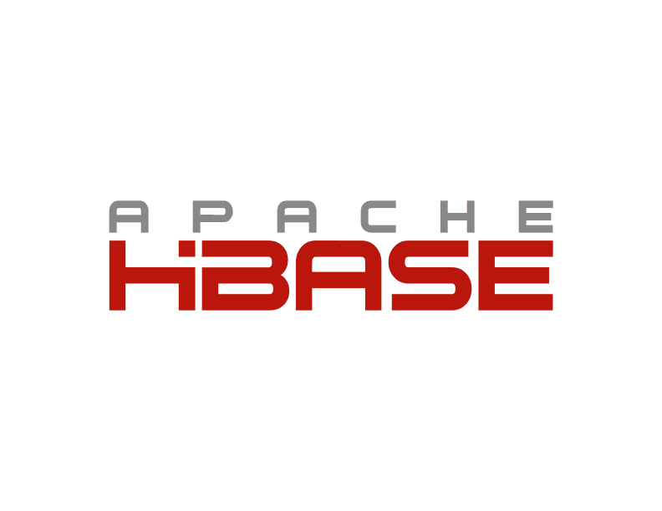


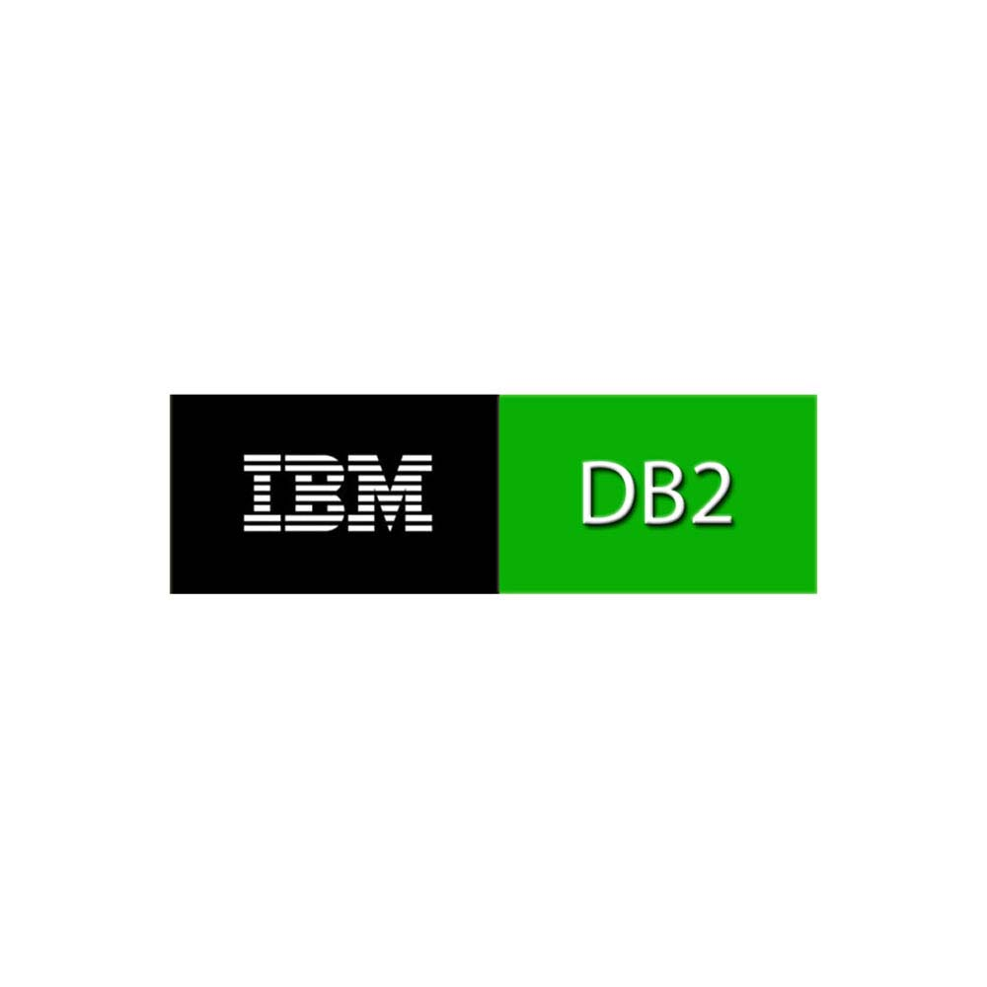

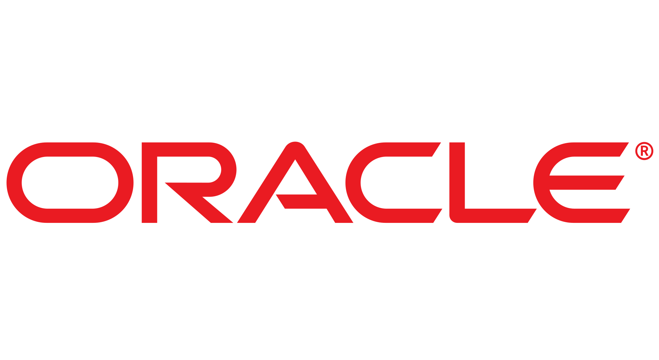
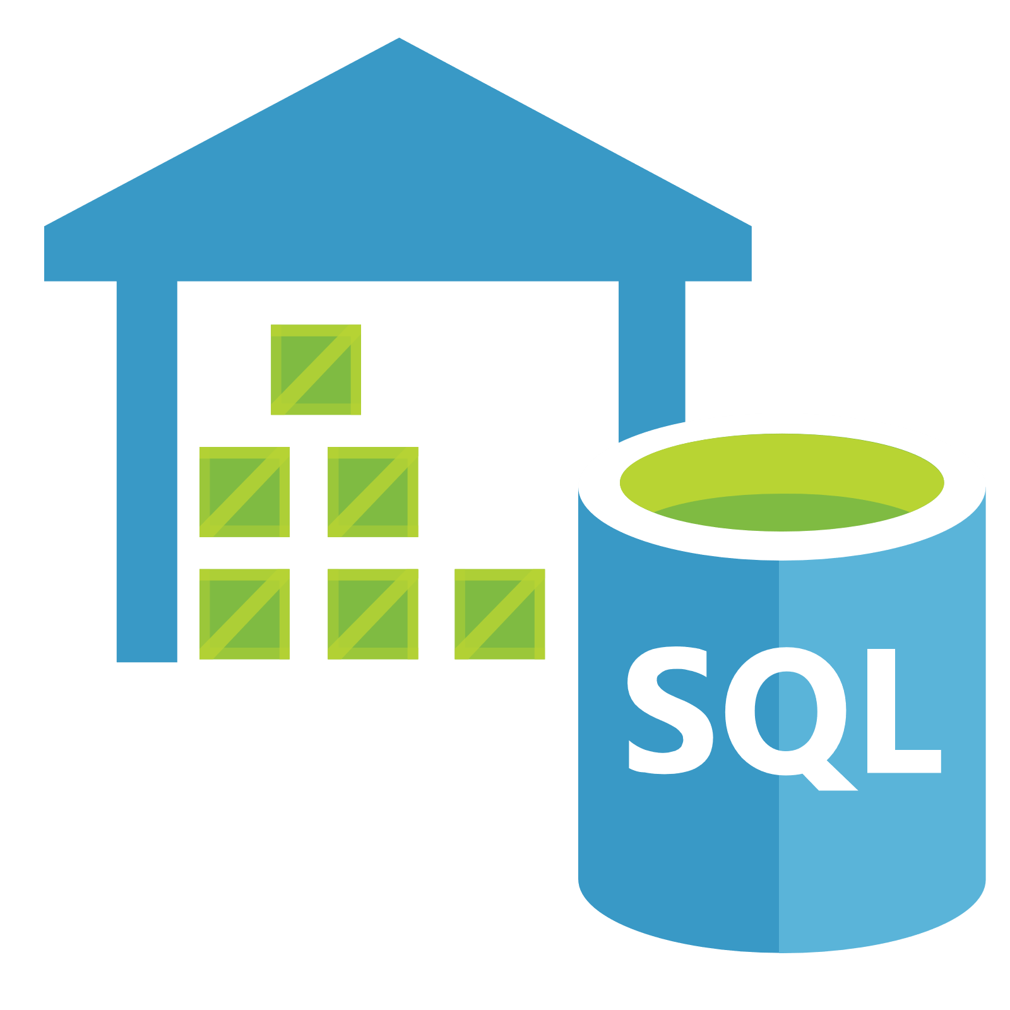




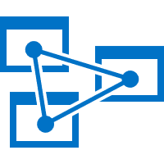




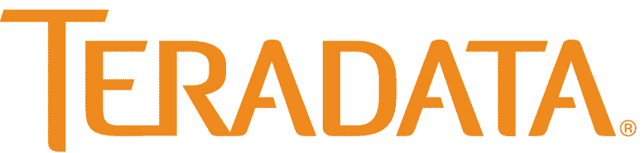

Which database?
High Concurrency
Schema-Bound
Schema-Less
HDInsight
Low Concurrency

Slide 7
Which database?
High Concurrency
Relational OLTP
NoSQL
Schema-Bound
Schema-Less
Relational Data Warehousing
Distributed Data
Processing
Low Concurrency

Slide 8
NoSQL Options
Cloudstore
DynamoDB

Slide 9
Azure Cosmos DB
A FULLY-MANAGED GLOBALLY DISTRIBUTED DATABASE SERVICE BUILT TO GUARANTEE
EXTREMELY LOW LATENCY AND MASSIVE SCALE FOR MODERN APPS

Slide 10


Azure Cosmos DB
A globally distributed, massively scalable, multi-model database service
Elastic scale out
of storage & throughput
Guaranteed low latency at the 99th percentile
Five well-defined consistency models
Turnkey global distribution
Comprehensive SLAs
Notes:
Azure Cosmos DB offers the first globally distributed, multi-model database service for building planet scale apps. It’s been powering Microsoft’s internet-scale services for years, and now it’s ready to launch yours.
You can add Azure locations to your database anywhere across the world, at any time, with a single click. Cosmos DB will seamlessly replicate your data and make it highly available.
Cosmos DB allows you to scale throughput and storage elastically, and globally! You only pay for the throughput and storage you need – anywhere in the world, at any time.

Slide 11
Azure Cosmos DB
A globally distributed, massively scalable, multi-model database service
Column-family
Document
Key-value
Graph
Elastic scale out
of storage & throughput
Guaranteed low latency at the 99th percentile
Five well-defined consistency models
Turnkey global distribution
Comprehensive SLAs
Notes:
Azure Cosmos DB offers the first globally distributed, multi-model database service for building planet scale apps. It’s been powering Microsoft’s internet-scale services for years, and now it’s ready to launch yours.
You can add Azure locations to your database anywhere across the world, at any time, with a single click. Cosmos DB will seamlessly replicate your data and make it highly available.
Cosmos DB allows you to scale throughput and storage elastically, and globally! You only pay for the throughput and storage you need – anywhere in the world, at any time.

Slide 12


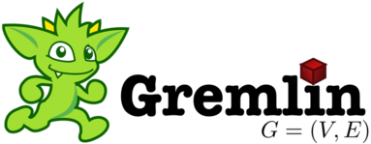
Azure Cosmos DB
A globally distributed, massively scalable, multi-model database service
Cosmos DB’s API for
MongoDB
Table API
Column-family
Document
Key-value
Graph
Elastic scale out
of storage & throughput
Guaranteed low latency at the 99th percentile
Five well-defined consistency models
Turnkey global distribution
Comprehensive SLAs
Notes:
Azure Cosmos DB offers the first globally distributed, multi-model database service for building planet scale apps. It’s been powering Microsoft’s internet-scale services for years, and now it’s ready to launch yours.
You can add Azure locations to your database anywhere across the world, at any time, with a single click. Cosmos DB will seamlessly replicate your data and make it highly available.
Cosmos DB allows you to scale throughput and storage elastically, and globally! You only pay for the throughput and storage you need – anywhere in the world, at any time.

Slide 13
Overview & Value Proposition

Slide 14
Elastically Scale Storage and Throughput
Independently and elastically scale storage and throughput across regions – even during unpredictable traffic bursts – with a database that adapts to your app’s needs.
Elastically scale throughput from 10 to 100s of millions of requests/sec across multiple regions
Scale throughput automatically using autopilot mode
Only pay for the throughput and storage you need
Notes:
Particularly useful for:
Small storage – large throughput (e.g. notification broadcast/poll)
Large storage – small throughput (e.g. classic data/log store)
Many customers (for example, online retailers) need to scale throughput up & down during different times of the year. Retailers, for example, have much higher numbers of read/writes in November and December since most shopping occurs during the holiday season. Azure Cosmos DB’s ability to easily scale up & down

Slide 15
Guaranteed Low Latency
Provide users around the world with fast access to data
Serve single digit millisecond reads and writes
Guarantee that reads and writes of documents 1 KB or smaller will be < 10 ms at the 99% percentile
Notes:
Cosmos DB’s is one of few databases to have a financially back latency. Every database likes to claim that they are the fastest- Azure Cosmos DB goes a step further and puts an SLA on P99 latency.
This reliability low latency makes Azure Cosmos DB a great fit for any applications with real-time requirements. In many applications, a few extra milliseconds of latency can have a significant impact on customer satisfaction.

Slide 16
Turnkey Global Distribution
Put your data where your users are in minutes
Automatically replicate all your data around the world, and across more regions than Amazon and Google combined.
Available in all Azure regions
Manual and automatic failover
Automatic & synchronous multi-region replication
Configure multiple write regions to further reduce latency and increase availability
Notes:
More info on global distribution in Azure Cosmos DB: https://docs.microsoft.com/en-us/azure/cosmos-db/distribute-data-globally

Slide 17
Five Well-Defined Consistency Models
Choose the best consistency model for your app
Offers five consistency models
Provides control over performance-consistency tradeoffs, backed by comprehensive SLAs.
An intuitive programming model offering low latency and high availability for your planet-scale app.
Strong
Bounded-stateless
Session
Consistent prefix
Eventual
Notes:
Tunable Consistency -> Single digit latency
Instead of forcing you to choose between eventual and strong consistency, Cosmos DB gives you many additional useful options.
Bounded Staleness - Consistent Prefix. Reads lag behind writes by k prefixes or t interval
Session - Consistent Prefix. Monotonic reads, monotonic writes, read-your-writes, write-follows-reads
Consistent Prefix - Updates returned are some prefix of all the updates, with no gaps

Slide 18


Multiple Data Models and APIs
Use the model that fits your requirements, and the apis, tools, and frameworks you prefer
Cosmos DB offers a multitude of APIs to access and query data including, SQL, various popular OSS APIs, and native support for NoSQL workloads.
Use key-value, columnar, graph, and document data
Data is automatically indexed, with no schema or secondary indexes required
Blazing fast queries with no lag
MongoDB
Table API
SQL
Column-family
Document
Key-value
Graph
Notes:
Multi – Model -> Elastic Scale out
For any new app you are building on Azure Cosmos DB, we recommend the SQL API.
We have created Cassandra, API for Mongo DB, and Tables API for apps that are being migrated from these existing NoSQL databases to Azure Cosmos DB. This allows customers to experience the low latency and global distribution core features of Azure Cosmos DB without needing to alter their data model or application code.

Slide 19
Handle any Data with no Schema or Indexing Required
Azure Cosmos DB’s schema-less service automatically indexes all your data, regardless of the data model, to delivery blazing fast queries.
Automatic index management
Synchronous auto-indexing
Freedom from schema + index management
Works across every data model
Ingest and serve data back out in milliseconds
GEEK
Item | Color | Microwave safe | Liquid capacity | CPU | Memory | Storage
Geek mug | Graphite | Yes | 16ox | ??? | ??? | ???
Coffee Bean mug | Tan | No | 12oz | ??? | ??? | ???
Surface book | Gray | ??? | ??? | 3.4 GHz Intel Skylake Core i7-6600U | 16GB | 1 TB SSD
Notes:
Automatic and synchronous indexing of all ingested content - hash, range, geo-spatial, and columnar
No schemas or secondary indices ever needed
Resource governed, write optimized database engine with latch free and log structured techniques
Online and in-situ index transformations
While the database is fully schema-agnostic, schema-extraction is built in

Slide 20
Comprehensive SLAs
Run your app on world-class infrastructure.
Azure Cosmos DB is the only service with financially-backed SLAs for millisecond latency at the 99th percentile, 99.999% HA and guaranteed throughput and consistency
Latency
HA
Throughput
Consistency
<10 ms
99.999%
Guaranteed
Guaranteed
99th percentile
Notes:
HA 99.999% for multi-region read; 99.99% for single region deployments

Slide 21
Trust your Data to Industry-Leading Security & Compliance
Azure is the world’s most trusted cloud, with more certifications than any other cloud provider.
Enterprise grade security
Encryption at Rest and Transit
Encryption is enabled automatically by default
Comprehensive Azure compliance certification
Notes:
Encryption at Rest
Always encrypted at rest and in motion
Data, index, backups, and attachments encrypted
Encryption is enabled automatically by default
No impact on performance, throughput or availability
Transparent to your application
Comprehensive Azure compliance certification
ISO 27001, ISO 27018, EUMC, HIPAA, PCI
SOC1 and SOC2 (Audit complete, Certification in Q2 2017)
FedRAMP, IRS 1075, UK Official (IL2) (Q2 2017)
HITRUST (H2 2017)
Updated and added to monthly

Slide 22
Top 10 Reasons Why Customers Use Azure Cosmos DB
The 1st and only database with global distribution turnkey capability
Deliver massive storage/throughput scalability database
Provides guaranteed single digit millisecond latency at 99th percentile worldwide
Natively supports different types of data at massive scale
Boasts 5 well-defined consistency models to pick the right consistency/latency/ throughput tradeoff
Enables mission critical intelligent applications
Gives high flexibility to optimize for speed and cost
Tackles big data workloads with high availability and reliability
Provides multi-tenancy and enterprise-grade security
Naturally analytics-ready and perfect for event-driven architectures

Slide 23
Azure Cosmos DB Optimization

Slide 24
Data Modeling

Slide 25
For guidance in delivering this section please view the following:
https://www.bing.com/videos/search?q=cosmos+db+data+modeling+ignite+youtube&view=detail&mid=36B6E05A0FD76BB99B7F36B6E05A0FD76BB99B7F&FORM=VIRE

Slide 26
Data Modeling
Is just as important with relational data!
There’s still a schema – just enforced at the application level
Plan upfront for best performance & costs
Feedback: “Small collections add up ->$$$”
Answer: Smart data modelling will help

Slide 27

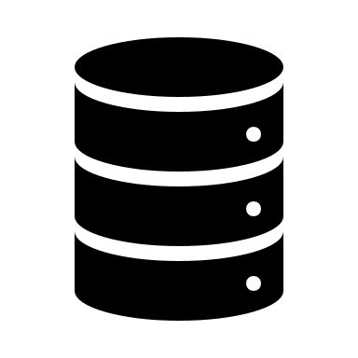



2 Extremes
ORM
SQL
Normalize everything
NoSQL
Embed as 1 piece

Slide 28
Contoso Restaurant Menu
Menu Item
------------
ID
Item Name
Item Description
Item Category ID
Category
------------
ID
Category Name
Category Description
Relational modelling – Each menu item has a reference to a category.
{
"ID": 1,
"ItemName": "hamburger",
"ItemDescription": "cheeseburger, no cheese",
“CategoryId": 5,
"Category": "sandwiches"
"CategoryDescription": "2 pieces of bread + filling"
}
Non-relational modeling – each menu item is a self-contained document

Slide 29




Number 1 question…
“Where are my joins?”
“Where are my joins!?!?”
Naïve way: Normalize, make 2 network calls, merge client side
But! We can model our data in a way to get the same functionality of a join, without the tradeoff

Slide 30
Modeling Challenges
#1: To de-normalize, or normalize? To embed, or to reference?
#2: Put data types in same collection, or different?

Slide 31
Modeling challenge #1: To embed or reference?
Embed
{
"menuID": 1,
"menuName": "Lunch menu",
"items": [
{"ID": 1, "ItemName": "hamburger", "ItemDescription":...}
{"ID": 2, "ItemName": "cheeseburger", "ItemDescription":...}
]
}
Reference
{
"menuID": 1,
"menuName": "Lunch menu",
"items": [
{"ID": 1}
{"ID": 2}
]
}
{"ID": 1, "ItemName": “hamburger", "ItemDescription":...}
{"ID": 2, "ItemName": “cheeseburger", "ItemDescription":...}

Slide 32
When To Embed #1
{
"ID": 1,
"ItemName": "hamburger",
"ItemDescription": "cheeseburger, no cheese",
"Category": "sandwiches",
"CategoryDescription": "2 pieces of bread + filling",
"Ingredients": [
{"ItemName": "bread", "calorieCount": 100, "Qty": "2 slices"},
{"ItemName": "lettuce", "calorieCount": 10, "Qty": "1 slice"}
{"ItemName": "tomato","calorieCount": 10, "Qty": "1 slice"}
{"ItemName": "patty", "calorieCount": 700, "Qty": "1"}
}
E.g. in Recipe, ingredients are always queried with the item

Slide 33
When To Embed #2
Child data is dependent/intrinsic to a parent
{
"id": "Order1",
"customer": "Customer1",
"orderDate": "2018-09-26",
"itemsOrdered": [
{"ID": 1, "ItemName": "hamburger", "Price":9.50, "Qty": 1}
{"ID": 2, "ItemName": "cheeseburger", "Price":9.50, "Qty": 499}
]
}
Items Ordered depends on Order

Slide 34
When To Embed #3
1:1 relationship
{
"id": "1",
"name": "Alice",
"email": "alice@contoso.com",
“phone": “555-5555"
“loyaltyNumber": 13838359,
"addresses": [
{"street": "1 Contoso Way", "city": "Seattle"},
{"street": "15 Fabrikam Lane", "city": "Orlando"}
]
}
All customers have email, phone, loyalty number for 1:1 relationship

Slide 35
When To Embed #4, #5
Similar rate of updates – does the data change at the same (slower) pace? -> Minimize writes
1:few relationships
{
"id": "1",
"name": "Alice",
"email": "alice@contoso.com",
"addresses": [
{"street": "1 Contoso Way", "city": "Seattle"},
{"street": "15 Fabrikam Lane", "city": "Orlando"}
]
}
//Email, addresses don’t change too often

Slide 36
When To Embed - Summary
Data from entities is queried together
Child data is dependent on a parent
1:1 relationship
Similar rate of updates – does the data change at the same pace
1:few – the set of values is bounded
Usually embedding provides better read performance
Follow-above to minimize trade-off for write perf

Slide 37
Modeling challenge #1: To embed or reference?
Embed
{
"menuID": 1,
"menuName": "Lunch menu",
"items": [
{"ID": 1, "ItemName": "hamburger", "ItemDescription":...}
{"ID": 2, "ItemName": "cheeseburger", "ItemDescription":...}
]
}
Reference
{
"menuID": 1,
"menuName": "Lunch menu",
"items": [
{"ID": 1}
{"ID": 2}
]
}
{"ID": 1, "ItemName": “hamburger", "ItemDescription":...}
{"ID": 2, "ItemName": “cheeseburger", "ItemDescription":...}

Slide 38
When To Reference #1
1 : many (unbounded relationship)
{
"id": "1",
"name": "Alice",
"email": "alice@contoso.com",
"Orders": [
{
"id": "Order1",
"orderDate": "2018-09-18",
"itemsOrdered": [
{"ID": 1, "ItemName": "hamburger", "Price":9.50, "Qty": 1}
{"ID": 2, "ItemName": "cheeseburger", "Price":9.50, "Qty": 499}]
},
...
{
"id": "OrderNfinity",
"orderDate": "2018-09-20",
"itemsOrdered": [
{"ID": 1, "ItemName": "hamburger", "Price":9.50, "Qty": 1}]
}]
}
Embedding doesn’t make sense:
Too many writes to same document
2MB document limit

Slide 39
When To Reference #2
Data changes at different rates #2
{
"id": "1",
"name": "Alice",
"email": "alice@contoso.com",
"stats":[
{"TotalNumberOrders": 100},
{"TotalAmountSpent": 550}]
}
Number of orders, amount spent will likely change faster than email
Guidance: Store these aggregate data in own document, and reference it

Slide 40
When To Reference #3
Many : Many relationships
{
"id": "speaker1",
"name": "Alice",
"email": "alice@contoso.com",
"sessions":[
{"id": "session1"},
{"id": "session2"}
]
}
{
"id": "session1",
"name": "Modelling Data 101",
"speakers":[
{"id": "speaker1"},
{"id": "speaker2"}
]
}
{
"id": "speaker2",
"name": "Bob",
"email": "bob@contoso.com",
"sessions":[
{"id": "session1"},
{"id": "session4"}
]
}
Speakers have multiple sessions
Sessions have multiple speakers
Have Speaker & Session documents

Slide 41
When To Reference #4
What is referenced, is heavily referenced by many others
{
"id": "speaker1",
"name": "Alice",
"email": "alice@contoso.com",
"sessions":[
{"id": "session1"},
{"id": "session2"}
]
}
{
"id": "session1",
"name": "Modelling Data 101",
"speakers":[
{"id": "speaker1"},
{"id": "speaker2"}
]
}
{
"id": “attendee1",
"name": “Eve",
"email": “eve@contoso.com",
“bookmarkedSessions":[
{"id": "session1"},
{"id": "session4"}
]
}
Here, session is referenced by speakers and attendees
Allows you to update Session independently

Slide 42
When To Reference Summary
1 : many (unbounded relationship)
many : many relationships
Data changes at different rates
What is referenced, is heavily referenced by many others
Typically provides better write performance
But may require more network calls for reads

Slide 43
But wait, you can do both!
{
"id": "speaker1",
"name": "Alice",
"email": "alice@contoso.com",
“address”: “1 Microsoft Way”
“phone”: “555-5555”
"sessions":[
{"id": "session1"},
{"id": "session2"}
]
}
{
"id": “session1",
"name": "Modelling Data 101",
"speakers":[
{"id": "speaker1“, “name”: “Alice”, “email”: “alice@contoso.com”},
{"id": "speaker2“, “name”: “Bob”}
]
}
Session
Speaker
Embed frequently used data, but use the reference to get less frequently used

Slide 44
Modeling Challenge #2: What entities go into a collection?
Relational: One entity per table
In Cosmos DB & NoSQL:
Option 1: One entity per collection
Option 2: Multiple entities per collection

Slide 45
Option 2: Multiple entities per collection
“Feels” weird, but it can greatly improve performance!
Makes sense when there are similar access patterns
If you need “join-like” capabilities, & data is not already embedded
Approach: Introduce “type” property

Slide 46
Approach- Introduce Type Property
Ability to query across multiple entity types with a single network request.
For example, we have two types of documents: person and cat
{
"id": "Ralph",
"type": "Cat",
"familyId": "Liu",
"fur": {
"length": "short",
"color": "brown"
}
}
{
"id": "Andrew",
"type": "Person",
"familyId": "Liu",
"worksOn": "Azure Cosmos DB"
}

Slide 47
Approach- Introduce Type Property
Ability to query across multiple entity types with a single network request.
For example, we have two types of documents: person and cat
{
"id": "Ralph",
"type": “Cat",
"familyId": "Liu",
"fur": {
"length": "short",
"color": "brown"
}
}
{
"id": "Andrew",
"type": "Person",
"familyId": "Liu",
"worksOn": "Azure Cosmos DB"
}
We can query both types of documents without needing a JOIN simply by running a query without a filter on type:
SELECT * FROM c WHERE c.familyId = "Liu"

Slide 48
Indexing

Slide 49
Handle any data with no schema or indexing required
Azure Cosmos DB’s schema-less service automatically indexes all your data, regardless of the data model, to delivery blazing fast queries.
Automatic index management
Synchronous auto-indexing
No schemas or secondary indices needed
Works across every data model
GEEK
Item | Color | Microwave safe | Liquid capacity | CPU | Memory | Storage
Geek mug | Graphite | Yes | 16ox | ??? | ??? | ???
Coffee Bean mug | Tan | No | 12oz | ??? | ??? | ???
Surface book | Gray | ??? | ??? | 3.4 GHz Intel Skylake Core i7-6600U | 16GB | 1 TB SSD
Notes:
At global scale, schema/index management is hard
Automatic and synchronous indexing of all ingested content – range and geo-spatial
No need to define schemas or secondary indices upfront
Resource governed, write optimized database engine with latch free and log structured techniques
Online and in-situ index transformations

Slide 50
Indexing Policies
Custom Indexing Policies
Though all Azure Cosmos DB data is indexed by default, you can specify a custom indexing policy for your collections. Custom indexing policies allow you to design and customize the shape of your index while maintaining schema flexibility.
Define trade-offs between storage, write and query performance, and query consistency
Include or exclude documents and paths to and from the index
Configure various index types
{
"automatic": true,
"indexingMode": "Consistent",
"includedPaths": [{
"path": "/*",
"indexes": [{
"kind": “Range",
"dataType": "String",
"precision": -1
}, {
"kind": "Range",
"dataType": "Number",
"precision": -1
}, {
"kind": "Spatial",
"dataType": "Point"
}]
}],
"excludedPaths": [{
"path": "/nonIndexedContent/*"
}]
}
Notes:
Include or exclude documents and paths to and from the index
You can exclude or include specific documents in the index when you insert or replace the documents in the collection. You can also include or exclude specific JSON properties, also called paths, to be indexed across documents that are included in an index. Paths include wildcard patterns.
Configure various index types
For each included path, you can specify the type of index the path requires for a collection. You can specify the type of index based on the path's data, the expected query workload, and numeric/string “precision.”
Configure index update modes
Azure Cosmos DB supports two indexing modes: Consistent and None. You can configure the indexing modes via the indexing policy on an Azure Cosmos DB collection.

Slide 51
Indexing JSON Documents
{
"locations": [
{
"country": "Germany",
"city": "Berlin"
},
{
"country": "France",
"city": "Paris"
}
],
"headquarter": "Belgium",
"exports": [
{ "city": "Moscow" },
{ "city": "Athens" }
]
}
locations
headquarter
exports
0
1
Belgium
0
1
country
city
country
city
city
city
Germany
Berlin
France
Paris
Moscow
Athens

Slide 52
Indexing JSON Documents
{
"locations": [
{
"country": "Germany",
"city": "Bonn",
"revenue": 200
}
],
"headquarter": "Italy",
"exports": [
{
"city": "Berlin",
"dealers": [
{ "name": "Hans" }
]
},
{ "city": "Athens" }
]
}
locations
headquarter
exports
0
Italy
0
1
country
city
revenue
city
dealers
city
Germany
Bonn
200
Berlin
0
name
Hans

Slide 53
Indexing JSON Documents
locations
headquarter
exports
locations
headquarter
exports
+
0
1
Belgium
0
1
0
Italy
0
1
country
city
country
city
city
city
country
city
revenue
city
dealers
city
Germany
Berlin
France
Paris
Moscow
Athens
Germany
Bonn
200
Berlin
0
Athens
name
Hans
Notes:
{
"locations": [
{
"country": "Germany",
"city": "Berlin"
},
{
"country": "France",
"city": "Paris"
}
],
"headquarter": "Belgium",
"exports": [
{ "city": "Moscow" },
{ "city": "Athens" }
]
}
{
"locations": [
{
"country": "Germany",
"city": "Bonn",
"revenue": 200
}
],
"headquarter": "Italy",
"exports": [
{
"city": "Berlin",
"dealers": [
{ "name": "Hans" }
]
},
{ "city": "Athens" }
]
}

Slide 54
Inverted Index
{1, 2}
{1, 2}
locations
{1, 2}
headquarter
{1, 2}
exports
{1, 2}
0
{1}
1
{1}
Belgium
{2}
Italy
{1, 2}
0
{1, 2}
1
{1, 2}
country
{1, 2}
city
{1, 2}
revenue
{1, 2}
country
{1, 2}
city
{1, 2}
city
{2}
dealers
{1, 2}
city
{1}
Berlin
{1}
France
{1}
Paris
{1}
Moscow
{1, 2}
Germany
{2}
Bonn
{2}
200
{2}
Berlin
{2}
0
{2}
Athens
{2}
name
{2}
Hans

Slide 55
Indexing Policy
{
"indexingMode": "consistent",
"automatic": true,
"includedPaths": [
{
"path": "/age/?",
"indexes": [
{
"kind": "Range",
"dataType": "Number",
"precision": -1
},
]
},
{
"path": "/gender/?",
"indexes": [
{
"kind": "Range",
"dataType": "String",
"precision": -1
},
]
}
],
"excludedPaths": [
{
"path": "/*"
}
]
}
{
"indexingMode": "none",
"automatic": false,
"includedPaths": [],
"excludedPaths": []
}
No indexing
Index some properties

Slide 56
Range Indexes
These are created by default for each property and are needed for:
Equality queries:
SELECT * FROM container c WHERE c.property = 'value’
Range queries:
SELECT * FROM container c WHERE c.property > 'value' (works for >, <, >=, <=, !=)
ORDER BY queries:
SELECT * FROM container c ORDER BY c.property
JOIN queries:
SELECT child FROM container c JOIN child IN c.properties WHERE child = 'value'

Slide 57
Spatial Indexes
These must be added and are needed for geospatial queries:
Geospatial distance queries:
SELECT * FROM container c WHERE ST_DISTANCE(c.property, { "type": "Point", "coordinates": [0.0, 10.0] }) < 40
Geospatial within queries:
SELECT * FROM container c WHERE ST_WITHIN(c.property, {"type": "Point", "coordinates": [0.0, 10.0] } })

Slide 58
Composite Indexes
These must be added and are needed for queries that ORDER BY two or more properties.
ORDER BY queries on multiple properties:
SELECT * FROM container c ORDER BY c.firstName, c.lastName

Slide 59
Online Index Transformations
On-the-fly Index Changes
In Azure Cosmos DB, you can make changes to the indexing policy of a collection on the fly. Changes can affect the shape of the index, including paths, precision values, and its consistency model.
A change in indexing policy effectively requires a transformation of the old index into a new index.
v1 Policy
v2 Policy
New document writes (CRUD) & queries
t₀
t₁
PUT /colls/examplecollection { indexingPolicy: … }
GET /colls/examplecollection x-ms-index-transformation-progress: 100
Notes:
Index transformations are made online. This means that the documents indexed per the old policy are efficiently transformed per the new policy without affecting the write availability or the provisioned throughput of the collection. The consistency of read and write operations made by using the REST API, SDKs, or from within stored procedures and triggers is not affected during index transformation. There's no performance degradation or downtime to your apps when you make an indexing policy change.

Slide 60
Index Tuning
Metrics Analysis
The SQL APIs provide information about performance metrics, such as the index storage used and the throughput cost (request units) for every operation. You can use this information to compare various indexing policies, and for performance tuning.
When running a HEAD or GET request against a collection resource, the x-ms-request-quota and the x-ms-request-usage headers provide the storage quota and usage of the collection.
You can use this information to compare various indexing policies, and for performance tuning.
Update Index Policy
View Headers
Query Collection
Index
Collection
Notes:
Update index policy
Query collection
View Results
Repeat Step 1

Slide 61
Best Practices
Understand query patterns – which properties are being used?
Understand impact on write cost – index update RU cost scales with # properties

Slide 62
Request Units & Billing

Slide 63
Billing Model
Two components: Consumed Storage + Provisioned Throughput
You are billed on consumed storage and provisioned throughput
Containers in a database can share throughput
Unit | Price (for most Azure regions)
SSD Storage (per GB) | $0.25 per month
Provisioned Throughput (single region writes) | $0.008/hour per 100 RU/s
Provisioned Throughput (multi-region writes) | $0.016/hour per 100 multi-region write RU/s
* pricing may vary by region; for up-to-date pricing, see: https://azure.microsoft.com/pricing/details/cosmos-db/

Slide 64
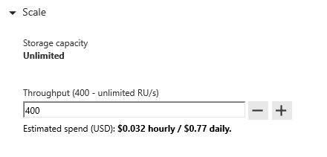
Request Units
Request Units (RUs) is a rate-based currency – e.g. 1000 RU/second
Abstracts physical resources for performing requests
% Memory
% CPU
% IOPS

Slide 65
Request Units
Each request consumes # of RU
Approx. 1 RU = 1 read of 1 KB document
Approx. 5 RU = 1 write of a 1KB document
Query: Depends on query & documents involved
GET
=
POST
=
PUT
=
Query
=
…
Notes:
The number of RU’s each operation consumes depends on many factors which include:
Document size
Number of indexed fields
Type of indexes
Consistency model choice
Not all queries will consume equal numbers of RU’s. Some operations are more computationally complex or require scans through more documents and therefore use more RU’s.

Slide 66
Request Units- Provisioned throughput
Provisioned in terms of RU/sec – e.g. 1000 RU/s
Billed for highest RU/s in 1 hour
Easy to increase and decrease on demand
Rate limiting based on amount of throughput provisioned
Background processes like TTL expiration, index transformations scheduled when quiescent
Rate limiting – SDK retry
Max RU/sec
Incoming Requests
No rate limiting
Min RU/sec
No rate limiting, process background operations
Notes:
We want to avoid throttling (rate limiting)

Slide 67
Estimating Required RUs
Operation Type | # Requests per sec | # RUs per Request | RUs Needed
Write Single Document | 10,000 | 10 | 100,000
Top Query #1 | 700 | 100 | 70,000
Top Query #2 | 200 | 100 | 20,000
Top Query #3 | 100 | 100 | 10,000
Total RU/s |  |  | 200,000 RU/s
Guidance:
Identify query & access patterns – e.g. top 5 queries, or # reads/writes per second
Use ‘Request Charge’ property from SDK + sample document to see # RU / operation
POC / Load test -> Scale up, and scale down

Slide 68
Autopilot Mode for Throughput
While it is easy to estimate and scale throughput in Azure Cosmos DB, some customers prefer if scaling is managed automatically
When enabling autopilot mode on Cosmos containers, customers only need to specify a maximum throughput (Tmax) not be exceeded.
Containers will scale instantly and automatically based on workload needs
Containers will scale between 0.1*Tmax and Tmax

Slide 69
Autopilot Mode vs Manually Provisioned Throughput
Azure Cosmos containers that are configured in autopilot mode have the following benefits:
Simple – There is no need to invest time in manually scaling throughput or writing code to automatically scale throughput
Reliable – Autopilot scaling is fully managed by Microsoft. There is no disruption to client connections, applications, or impact to SLA’s.
No rate-limiting of operations – Rate limiting (throttled requests) will not happen if throughput consumed is within the max throughput chosen for autopilot mode.
Autopilot mode pricing:
Single-region write accounts- Cost for provisioned RU’s is 50% higher
Multi-region write accounts- Cost for provisioned RU’s is identical to cost of manually provisioned throughput RU’s

Slide 70
Database Level Throughput
You can provision throughput at the database level instead of individually for each container
Throughput is shared among each designated container within the database
You can provision dedicated throughput for some containers

Slide 71
Database vs Container Level Throughput
In general, container level throughput is a good choice. This leads to predictable performance since each container is guaranteed its provisioned RU’s.
Choosing Database Level Throughput can also be a good option if:
You are migrating many containers in a lift and shift migration (from Table Storage, MongoDB, or Cassandra) and do not know how much throughput to set for each one
You have containers that are timeshared
Multitenant applications where each user is represented by a separate container

Slide 72
Pricing Example – Do this exercise to ballpark cost + RU/s required
Storage Cost
Avg Record Size (KB) | 1
Number of Records | 100,000,000
Total Storage (GB) | 100
Monthly Cost per GB | $0.25
Expected Monthly Cost for Storage | $25.00
Throughput Cost
Operation Type | Number of Requests per sec | Avg RU's per Request | RU's Needed
Create | 100 | 5 | 500
Read | 400 | 1 | 400
Total RU/sec | 900
Hourly Cost per 100 RU/sec | $0.008
Monthly Cost per 100 RU/sec | $6.00
Expected Monthly Cost for Throughput | $54.00
Total Monthly Cost
[Total Monthly Cost] = [Monthly Cost for Storage] + [Monthly Cost for Throughput]
= $25 + $54
= $79 per month
* pricing may vary by region; for up-to-date pricing, see: https://azure.microsoft.com/pricing/details/cosmos-db/

Slide 73
Cosmos DB Provisioned Throughput FAQ
Is my bill dependent on how much provisioned throughput I consume?
No, your bill is based on provisioned throughput, not consumed throughput. Therefore, your bill is predictable. If you provision, say, 1000 RU’s you know you will be billed for exactly that amount.
Is it possible to scale provisioned throughput?
Yes, it is easily to scale provisioned throughput through the portal, Azure CLI, or sdk’s. You are only billed for the peak throughput that you provision during each hour.
How does Cosmos DB geo-replication affect pricing?
When you geo-replicate Cosmos DB accounts to additional regions, we have a full copy of your data (storage as well as RU’s) in each region. Therefore, you are billed for the total storage and provisioned RU’s across all regions. More information is here: https://azure.microsoft.com/en-us/pricing/details/cosmos-db/
I have a lot of collections and it’s very expensive. How can I reduce costs?
Cosmos DB gives you options to set throughput at either the database or container/collection level. You can simply provision throughput for a database and have this throughput shared among all selected collections within the database

Slide 74
Event sourcing

Slide 75
What is the event sourcing pattern?
An approach to handling operations on data -- driven by a sequence of events, each of which is recorded in an append-only store
Example: IoT devices send telemetry as a series of events that describe the state of each device over time to Azure Cosmos DB, where they're persisted. Each event represents a set of changes to the data, which is tied back to the source IoT device
Simply put: You have a stream of events you save to the data store, add in downstream consumers that react to and process the data; the data is ingested and processed by further downstream consumers, etc. etc.

Slide 76
Event sourcing: How do we ingest all this streaming data?

Slide 77


Event Hubs – cloud-scale telemetry ingestion
Big data pipeline Azure Event Hubs is a big data pipeline (can receive/process millions events/second)
Works with streaming data It facilitates the capture, retention, and replay of telemetry and event stream data (HTTPS, AMQP, AMQP over websockets, Kafka)
High throughput with optional ordering At least once delivery of events with low latency and high throughput. Event ordering ensured per partition
Ingest multiple sources simultaneously The data can come from many concurrent sources and up to 20 consumer groups can allow applications to read entire event hub independently at their own pace
Notes:
Stream millions of events per second in real-time
Send telemetry data automatically to storage, allowing you to process real-time and batch on the same stream
Read data from multiple applications and services using publish-subscribe semantics, including custom apps, Azure Functions, and Apache Spark
Up to 20 consumer groups can be used to allow consuming applications to read the entire event hub independently at their own pace
Partitions enable horizontal scale for event processing
Send events to the same partition to ensure order

Slide 78

IoT Hub – connect/monitor/manage billions IoT of assets
Big data pipeline IoT Hub uses Event Hubs for its telemetry path, so is also a big data pipeline (can receive/process millions events/second)
Per-device identity Secure your IoT solution from potential attacks with unique device-level identity; authorize and revoke device connections
Cloud-to-device messaging Send messages to devices from the cloud as direct messages for immediate confirmation, or device twin properties for long-running commands
Automate IoT device provisioning Speed up your IoT deployment by registering and provisioning devices with zero touch in a secure & reliable way
HTTPS, AMQP, AMQP over websockets,
MQTT, MQTT over websockets

Slide 79

Cosmos DB – ingest and serve data at global scale
Highly scalable across global regions Cosmos DB elastically scales globally for both storage (GB to PB) and throughput (100 to 100M requests/second)
Flexible document TTL Configure TTL (time-to-live) at the collection or document level to automatically delete messages after specified time
Change feed can trigger downstream processing Every time a document is added, updated, or deleted, the change feed can trigger services such as Azure Databricks or Azure functions to evaluate and process that data

Slide 80

Event Grid – react to and capture 1st party and custom events
Enables event-driven, reactive programming Uses a publish-subscribe model where publishers have no expectation of which events are handled
High scalability Serverless, in that you pay for what you use. Event Grid can scale to 10,000,000 events per second per region
Integrate with IoT Hub IoT Hub publishes device events (created, deleted, disconnected), but can now publish telemetry events (in preview). Event Grid offers 500 endpoints vs. 10 custom IoT Hub endpoints Do NOT use if message ordering is important

Slide 81
Event sourcing: How do we process this data?

Slide 82


Process streams using serverless
Azure Functions
Stream Analytics
Stream Analytics on IoT Edge
Uses EventProcessorHost to read data in near real-time from Event Hubs/IoT Hub Good for enriching streaming data where velocity around 100,000 events/second or less
C#, F#, Java, Node, Python, PowerShell
High volume event-processing engine using SQL-like language
Output to multiple data sinks such as Service Bus, Power BI, Cosmos DB, Event Hubs, SQL Database
SQL, C#/JavaScript UDFs
Uses same query language on both cloud and edge
Deploys to Docker container on IoT edge device
Good for filtering & aggregating data locally before sending to cloud

Slide 83
Azure Cosmos DB Change Feed

Slide 84
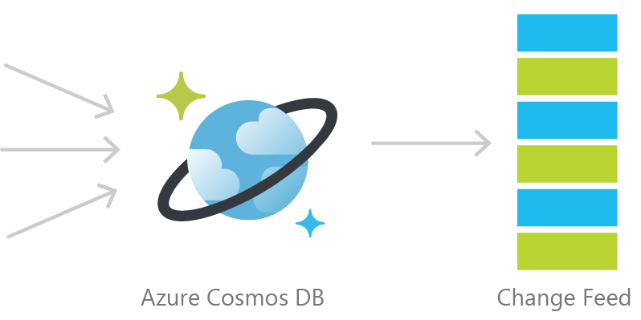
Cosmos DB Change Feed
Persistent log of documents within an Azure Cosmos DB collection in the order in which they were modified

Slide 85
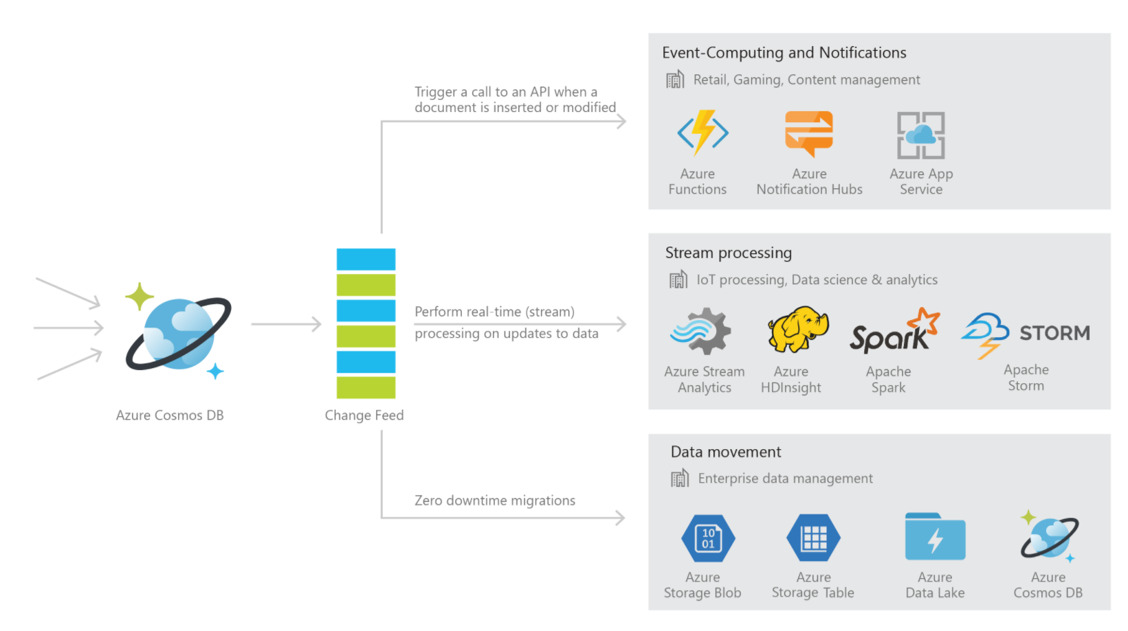
Common Change Feed Scenarios

Slide 86


Common Scenarios
Event Sourcing (Microservices)
Read From Change Feed
Persistent Event Store
Microservice
#1
Microservice #2
New Order
Microservice #3
Trigger Action From Change Feed

Slide 87



1. Retail Order Processing Pipelines
Azure Functions
(E-Commerce Checkout API)
Azure Cosmos DB (Order Event Store)
. . .
Azure Functions
(Microservice 1: Tax)
Azure Functions
(Microservice 2: Payment)
Azure Functions
(Microservice N: Fulfillment)

Slide 88
2. Real-time data movement
Backup Collection
Data Movement / Backup
Access upon main collection failure
Replicate Updates
Main Collection
Secondary Collections
CRUD Data
Read access, e.g. for analytics
…

Slide 89
2. Real-time data movement
This is useful for:
Performing a live migration from one Cosmos container to another
For example, to a container with a different partition key
Replicating data to another collection optimize for different read operations
For read-heavy workloads, sometimes it makes sense to replicate the same data two or more times (with different schema or different partition keys) to optimize for different read operation
Replicating data to another type of storage (colder storage with less-rich query capabilities such as Azure Blob Storage)
You can ingest data directly into Azure Cosmos DB and keep another data source synchronized. Then, you can set a TTL (time-to-live) on your Cosmos containers to have documents automatically deleted from Cosmos DB when the data is no longer “hot” and heavily accessed.

Slide 90
3. Materialized View
Application
Azure Cosmos DB
Materialized View
SubscriptionID | UserID | Create Date | …
123abc | Ben6 | 6/17/17
456efg | Ben6 | 3/14/17
789hij | Jen4 | 8/1/16
012klm | Joe3 | 3/4/17
UserID | Total Subscriptions
Ben6 | 2
Jen4 | 1
Joe3 | 1
Notes:
Demo available here: https://github.com/Azure-Samples/cosmosdb-materialized-views

Slide 91
Building a materialized view using the Azure Cosmos DB Change Feed
Notes:
Demo available here: https://github.com/Azure-Samples/cosmosdb-materialized-views.

Slide 92
Three different ways to use the Change Feed
Implementation | Use Case | Advantages
Azure Functions | Serverless applications | Easy to implement. Used as a trigger, input or output binding to an Azure Function.
Change Feed Processor Library | Distributed applications | Ability to distribute the processing of events towards multiple clients. Requires a “leases collection”.
SQL API SDK for .NET or Java | Not recommended | Requires manual implementation in a .NET or Java application.

Slide 93
Serverless and low code processing

Slide 94
What is serverless?
The simple answer:
It is the abstraction of servers, infrastructure, and operating systems. All of this plus capacity planning are invisible to you, and you pay only for resources consumed.
Focus on code, not infrastructure
Event-driven: resources allocated when triggered by event
Pay for what you use
Scale and high availability managed for you

Slide 95
Benefits of Azure Serverless for event-driven apps
Focus
Flexibility
Efficiency
Auto-scale based on workload
No infrastructure management
No wasted resources
Hosting options
Multiple languages
Development environments
Shorter time to market
Fully-managed services
End-to-end dev experience

Slide 96

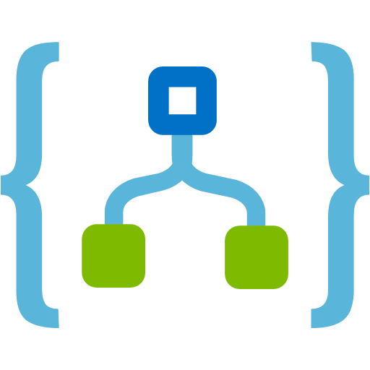



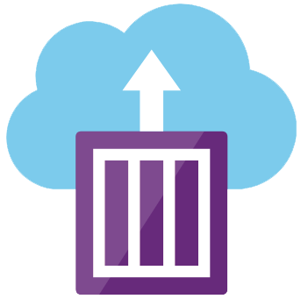

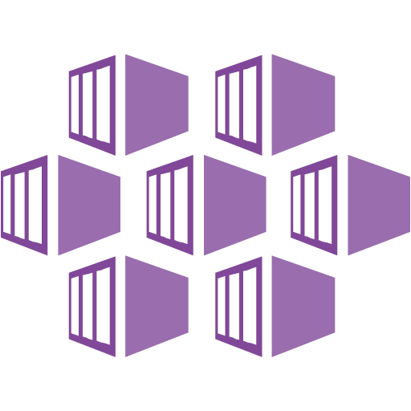
Serverless and related components in Azure
Compute & integration
Data & storage
Cloud messaging
Azure Functions
Azure Cosmos DB
Azure Event Grid
Event-driven compute,
polyglot, scale on demand
Global transparent scaling
and replication, multi-model
Event routing connects serverless
to events from apps or services
Logic Apps
Azure Storage
Service Bus
Serverless workflows,
tons of integrations
Flexible, highly available,
scalable for all workloads
Messaging infrastructure enabling
distributed cloud solutions
Analytics & ingest
API management
Containers
Event Hubs
API Management
Azure Container Instances
Mass ingest of millions of
data inputs/second at scale
Create, manage, monitor,
and secure APIs at scale
Per-second billing and container-
based compute on demand.
Azure Stream Analytics
Azure Functions Proxies
Azure Kubernetes Service
Analytics service for processing
real-time streaming data
Create single API surface for
multiple function apps, etc.
Fully managed Kubernetes container orchestration service

Slide 97
FaaS is at the center of serverless Functions-as-a-Service programming model use functions to achieve true serverless compute
Single responsibility
Functions are single-purposed, reusable pieces of code that process an input and return a result
Short lived
Functions don’t stick around when finished executing, freeing up resources for further executions
Stateless
Functions don’t hold any persistent state and don’t rely on the state of any other processes
Event driven & scalable
Functions respond to predefined events, and are instantly replicated as many times as needed

Slide 98
Azure Functions = FaaS++ An event-based, serverless compute experience that accelerates app development
Integrated programming model
Use built-in triggers and bindings to define when a function is invoked and to what data it connects
Enhanced development experience
Code, test, & debug locally using your preferred editor or easy-to-use web based interface
Hosting options flexibility
Choose the deployment model that best fits your business needs without compromising dev experience
Notes:
Building on top of the FaaS programming model, Azure Functions keep all the mentioned features and extend your possibilities with additional capabilities that help to reduce your development time and boost productivity, while using best in class tools.

Slide 99

Azure Functions
Dual Abstraction
Serverless compute abstracts away the compute
Bindings abstract away the services code interacts with to provide result of the code execution
Other Services
Business Logic
Serverless PaaS

Slide 100
Azure Logic Apps
Easily automate workflows and
orchestrate business processes
Out-of-the-box connectors reduce integration challenges
Connect and integrate data from cloud and on-premises systems
B2B and enterprise messaging in the cloud
Web-based graphic workflow designer

Slide 101
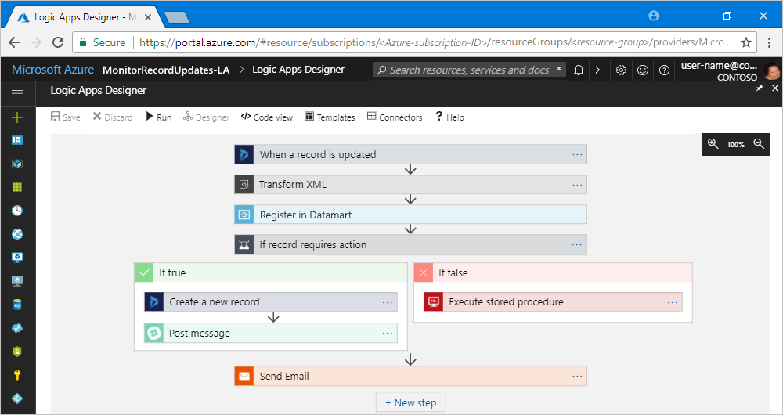
Logic App designer

Slide 102
Visualization

Slide 103

Visualizing data with Power BI
Power BI helps you create reports and static or real-time dashboards from local, on-prem, and Azure services
Create visualizations through a drag-and-drop interface with several out-of-the-box components

Slide 104
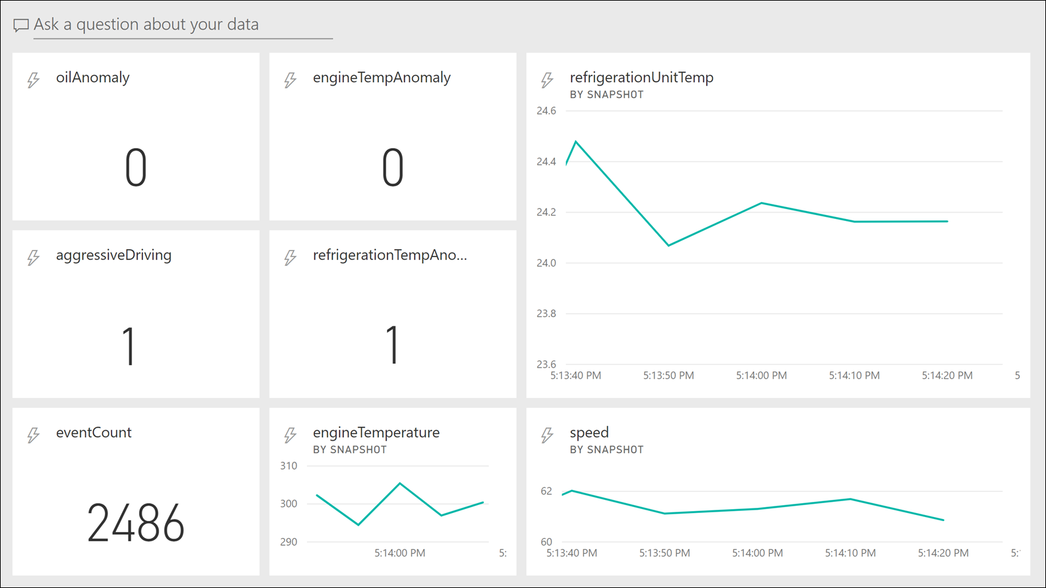
Use Power BI as a data sink for real-time dashboards

Slide 105
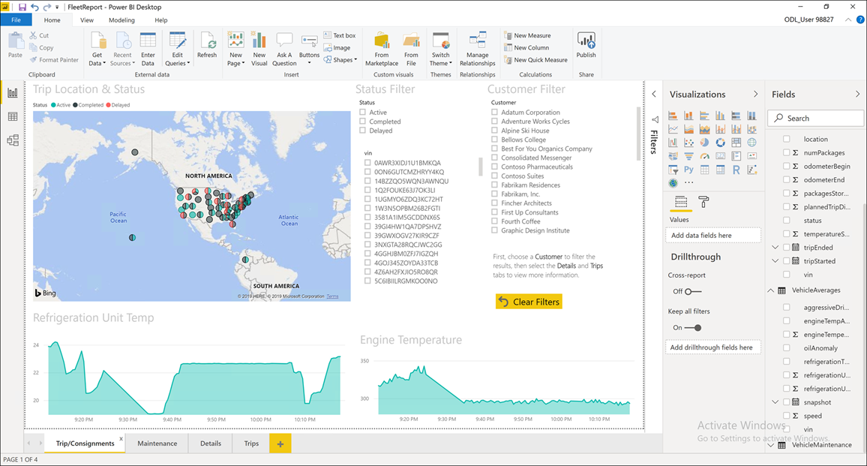
Build detailed, interactive reports with Power BI

Slide 106
Pre-compute aggregates in materialized views
Query from your application or Power BI
Application
Azure Cosmos DB
Materialized View
SubscriptionID | UserID | Create Date | …
123abc | Ben6 | 6/17/17
456efg | Ben6 | 3/14/17
789hij | Jen4 | 8/1/16
012klm | Joe3 | 3/4/17
UserID | Total Subscriptions
Ben6 | 2
Jen4 | 1
Joe3 | 1
Notes:
Demo available here: https://github.com/Azure-Samples/cosmosdb-materialized-views

Slide 107
IoT on Azure

Slide 108
Event Hubs – cloud-scale telemetry ingestion
Big data pipeline Azure Event Hubs is a big data pipeline (can receive/process millions events/second)
Works with streaming data It facilitates the capture, retention, and replay of telemetry and event stream data (HTTPS, AMQP, AMQP over websockets, Kafka)
High throughput with optional ordering At least once delivery of events with low latency and high throughput. Event ordering ensured per partition
Ingest multiple sources simultaneously The data can come from many concurrent sources and up to 20 consumer groups can allow applications to read entire event hub independently at their own pace
Notes:
Stream millions of events per second in real-time
Send telemetry data automatically to storage, allowing you to process real-time and batch on the same stream
Read data from multiple applications and services using publish-subscribe semantics, including custom apps, Azure Functions, and Apache Spark
Up to 20 consumer groups can be used to allow consuming applications to read the entire event hub independently at their own pace
Partitions enable horizontal scale for event processing
Send events to the same partition to ensure order

Slide 109
IoT Hub – connect/monitor/manage billions IoT of assets
Big data pipeline IoT Hub uses Event Hubs for its telemetry path, so is also a big data pipeline (can receive/process millions events/second)
Per-device identity Secure your IoT solution from potential attacks with unique device-level identity; authorize and revoke device connections
Cloud-to-device messaging Send messages to devices from the cloud as direct messages for immediate confirmation, or device twin properties for long-running commands
Automate IoT device provisioning Speed up your IoT deployment by registering and provisioning devices with zero touch in a secure & reliable way
HTTPS, AMQP, AMQP over websockets,
MQTT, MQTT over websockets

Slide 110
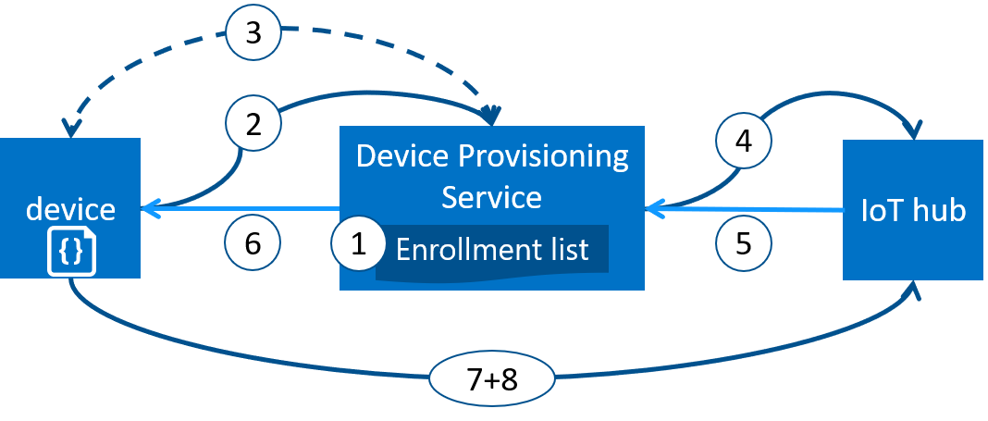
IoT Hub Device Provisioning Service (DPS)
Device manufacturer adds device registration in the portal
Device contacts provisioning service endpoint with identifying info to prove identity
DPS validates identity with registration ID and key
DPS registers the device with IoT Hub and populates its desired twin state
IoT Hub returns device ID info to DPS
DPS returns IoT Hub connection info to device. The device can start sending data directly to IoT Hub
Device connects to IoT Hub
Device gets desired state from its device twin in IoT Hub
Notes:
The IoT Hub Device Provisioning Service is a helper service for IoT Hub that enables zero-touch, just-in-time provisioning to the right IoT hub without requiring human intervention, enabling customers to provision millions of devices in a secure and scalable manner.

Slide 111
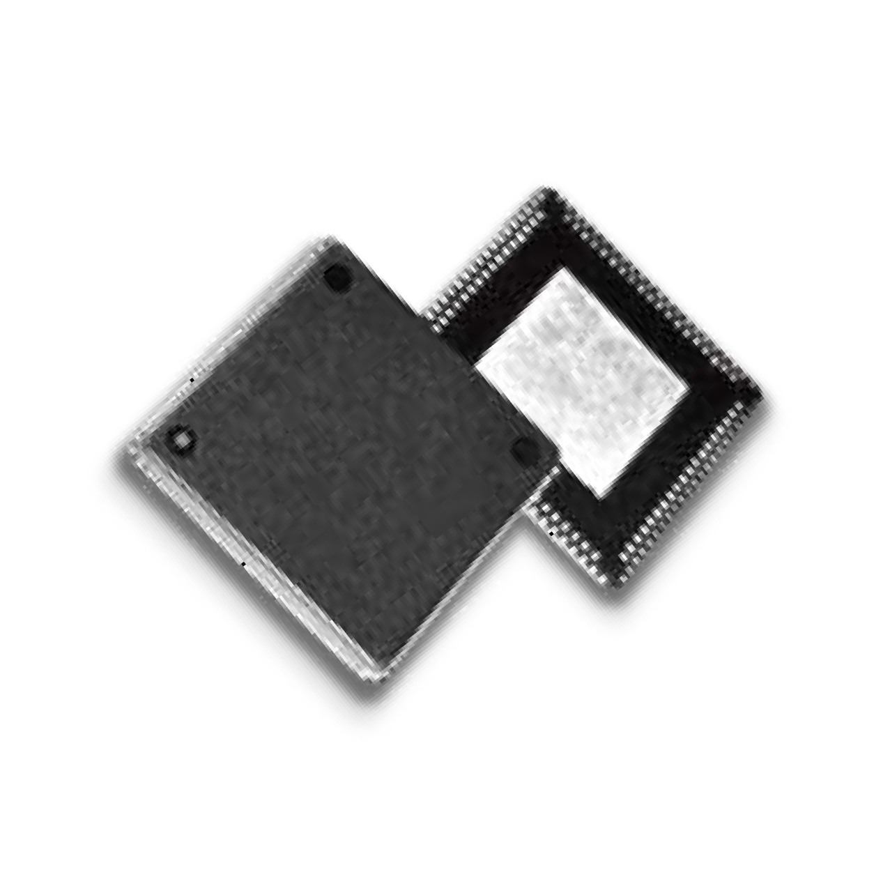

Azure Sphere empowers manufacturers to create highly-secured, connected MCU devices
Creating your own, secure, IoT devices:
S E C U R I T Y
Every device built with Azure Sphere is secured by Microsoft.
For its 10 year lifetime.
P R O D U C T I V I T Y
The Azure Sphere developer experience shortens OEM time to market.
O P P O RT U N I T Y
Azure Sphere empowers OEMs to create new customer experiences and business models.
© Microsoft Corporation
Notes:
The microcontroller (MCU) is a low-cost, single chip computer.

Slide 112


Azure Sphere is an end-to-end solution for securing MCU-powered devices
The microcontroller (MCU) is a
low-cost, single chip computer
New Azure Sphere OS secured by Microsoft for the devices 10-year lifetime to create a trustworthy platform for new IoT experiences
New Azure Sphere certified MCUs, from silicon partners, with built-in Microsoft security technology provide connectivity and a dependable hardware root of trust.
The Azure Sphere Security Service guards every Azure Sphere device; it brokers trust for device-to-device and device-to-cloud communication, detects emerging threats, and renews device security.
© Microsoft Corporation

Slide 113
The Azure Sphere OS is optimized for IoT, Security, and MCU agility
Azure Sphere OS Architecture
App Containers for POSIX (on Cortex-A) | App Containers for I/O (on Cortex-Ms)
On-chip Cloud Services
HLOS Kernel
Security Monitor
Azure Sphere certified MCUs
Secure Application Sandboxes
Compartmentalize code for agility, robustness & security
On-chip Cloud Services
Provide update, authentication, and connectivity
Custom Linux kernel
Empowers agile silicon evolution and reuse of code
Security Monitor
Guards integrity and access to critical resources
OS Layer 4
OS Layer 3
OS Layer 2
OS Layer 1
Hardware
© Microsoft Corporation

Slide 114
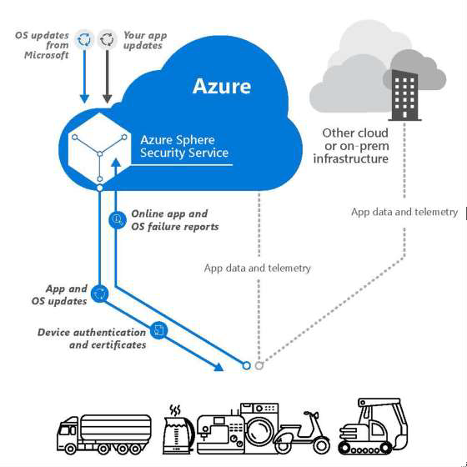
The Azure Sphere Security Service connects and protects every Azure Sphere device
Protects your devices and your customers with
certificate-based authentication of all communication
Detects emerging security threats through automated processing of on-device failures
Responds to threats with fully automated
on-device updates of OS
Allows for easy deployment of software updates to Azure Sphere powered devices
© Microsoft Corporation

Slide 115
Solution accelerator architecture

Slide 116
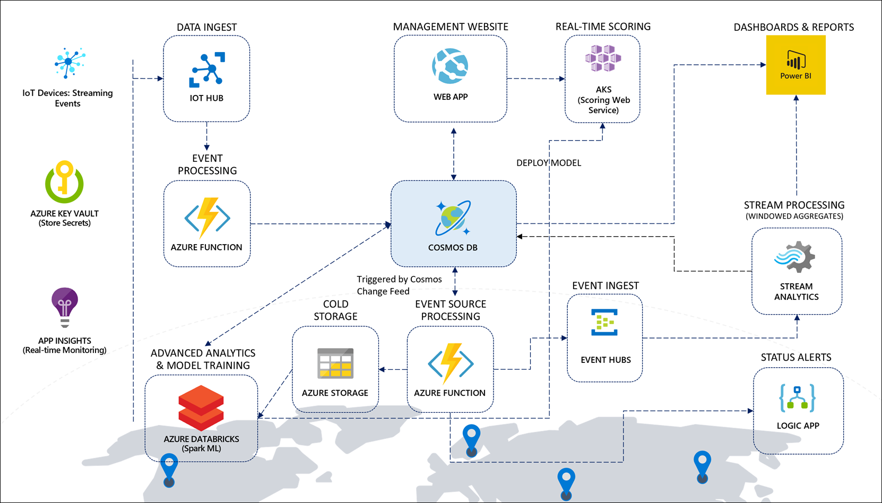

Slide 117
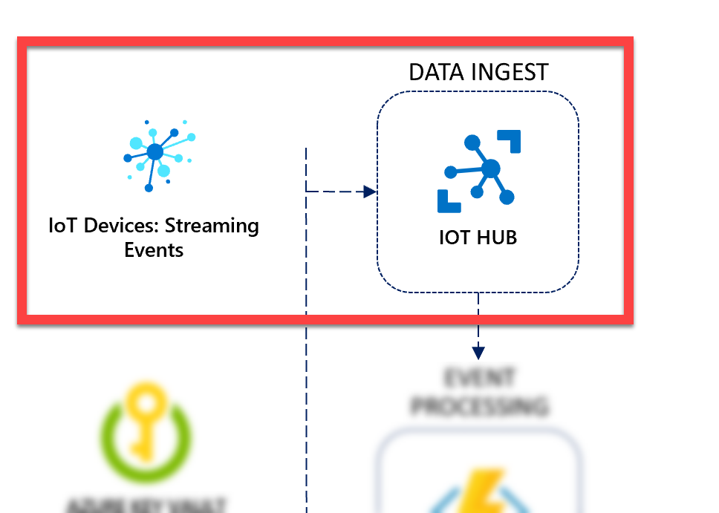
Cloud gateway: Managing of devices and ingesting telemetry with IoT Hub
IoT Hub manages IoT devices and ingests all streaming events
IoT Hub can send command messages back to devices
Capable of ingesting millions of events/second

Slide 118
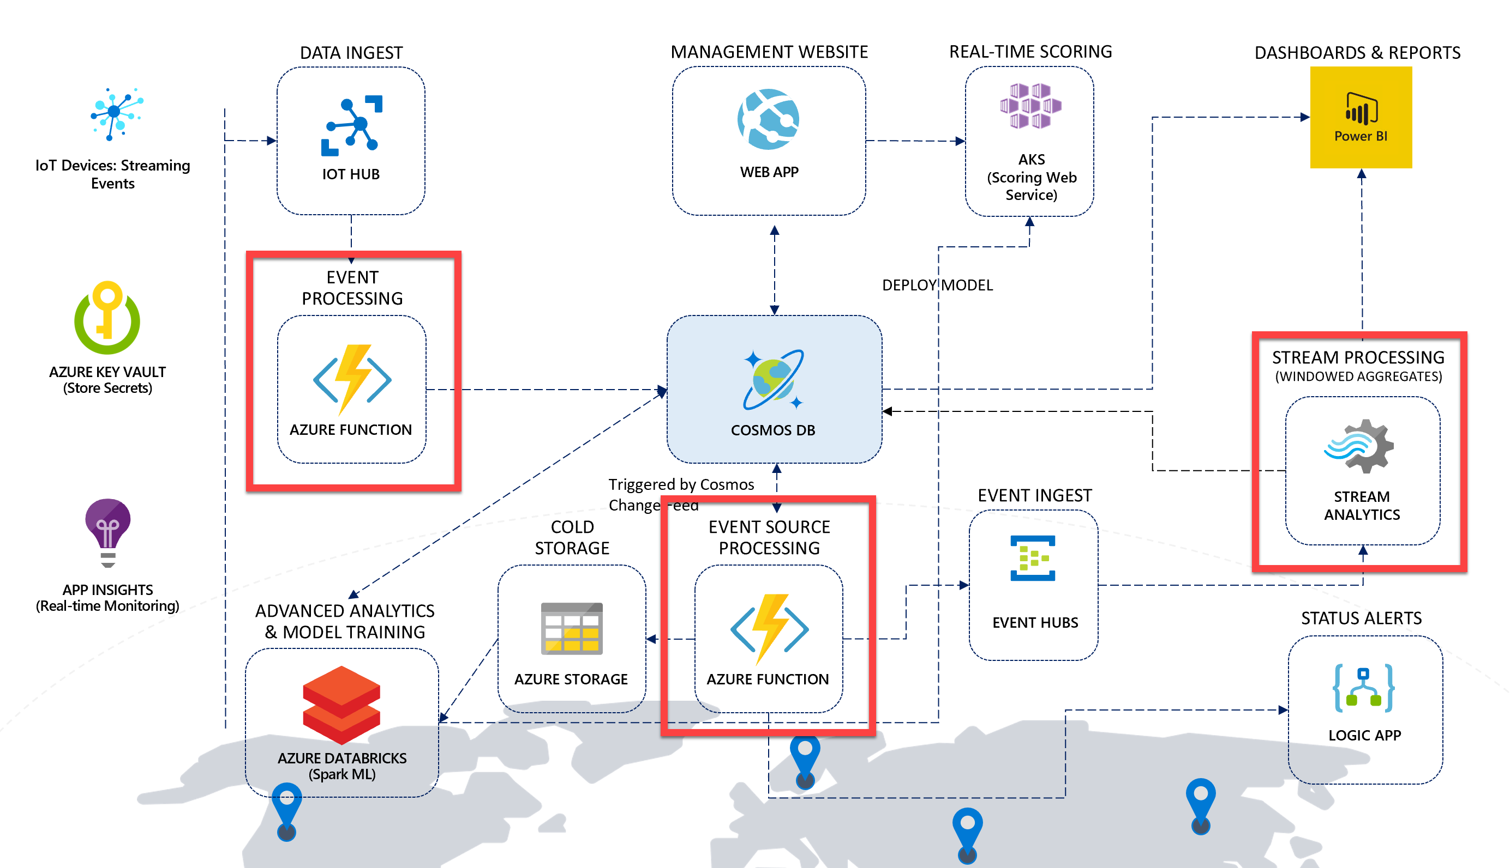
Implementing stream processing and the event sourcing pattern with Azure Functions and Stream Analytics

Slide 119
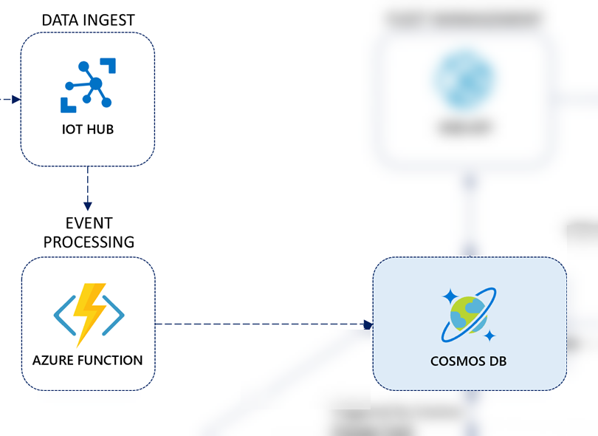
Event sourcing pattern: IoT Hub-triggered function
Function is automatically triggered by IoT Hub as vehicle telemetry is sent by the data generator
Performs some light processing to the data by defining the partition key value, the document's TTL, adds a timestamp value, then saves the information to Azure Cosmos DB

Slide 120
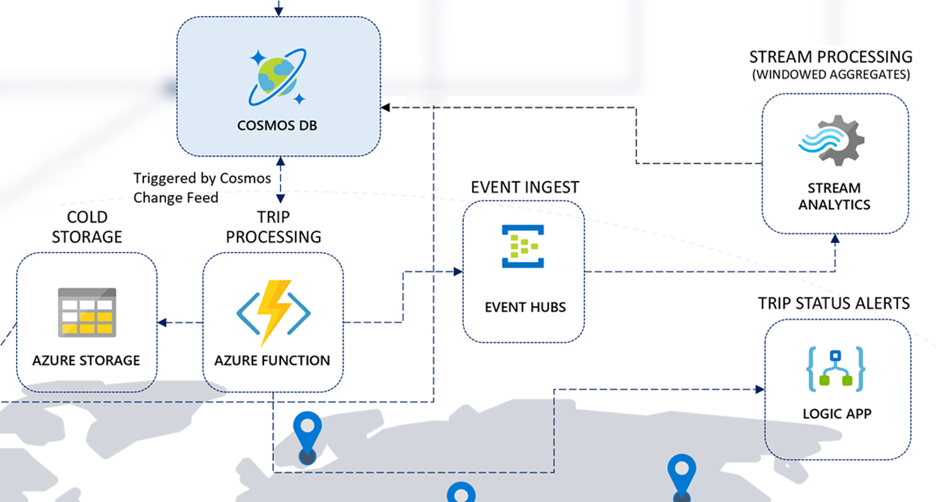
Event sourcing pattern: Change feed-triggered function
3 functions triggered by change feed
Sends data to Blob Storage
Calculates trip progress and sends alerts to a Logic App if needed
Sends enriched data to Event Hubs for downstream processing by Stream Analytics

Slide 121
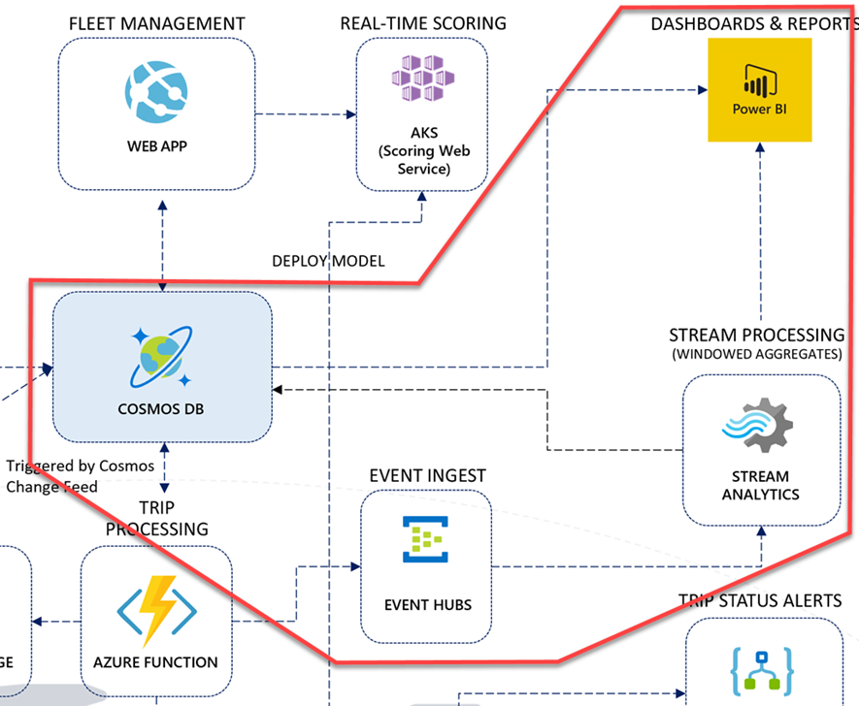
Event sourcing pattern: Creating materialized views & visualizations
Stream Analytics triggered by data sent to Event Hubs by the function
Creates windowed aggregates using a SQL-like query language
Saves larger windowed aggregates to Cosmos DB
Sends smaller windowed aggregates to Power BI real-time dashboard

Slide 122
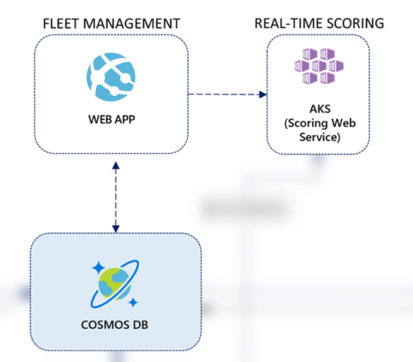
Data management through the web app
Azure Web App connects directly to Azure Cosmos DB through the .NET SDK
Allows users to manage trip and vehicle information
Calls to a deployed machine learning model hosted in Azure Kubernetes Service (AKS) to predict battery failure
Uses Azure Active Directory to authenticate users

Slide 123
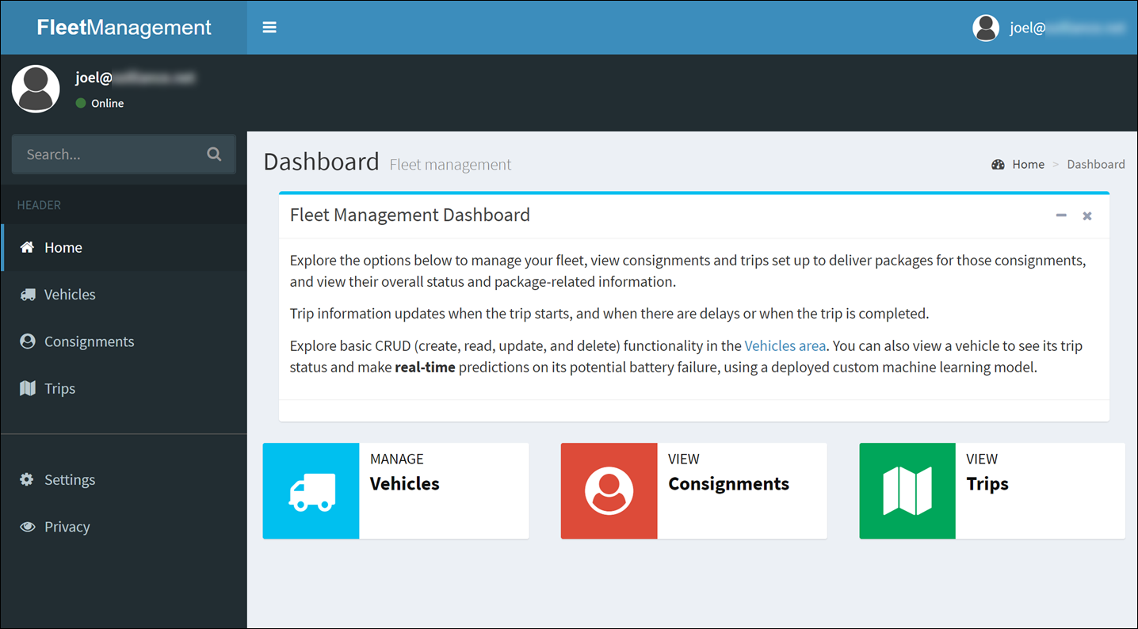
Data management through the web app

Slide 124
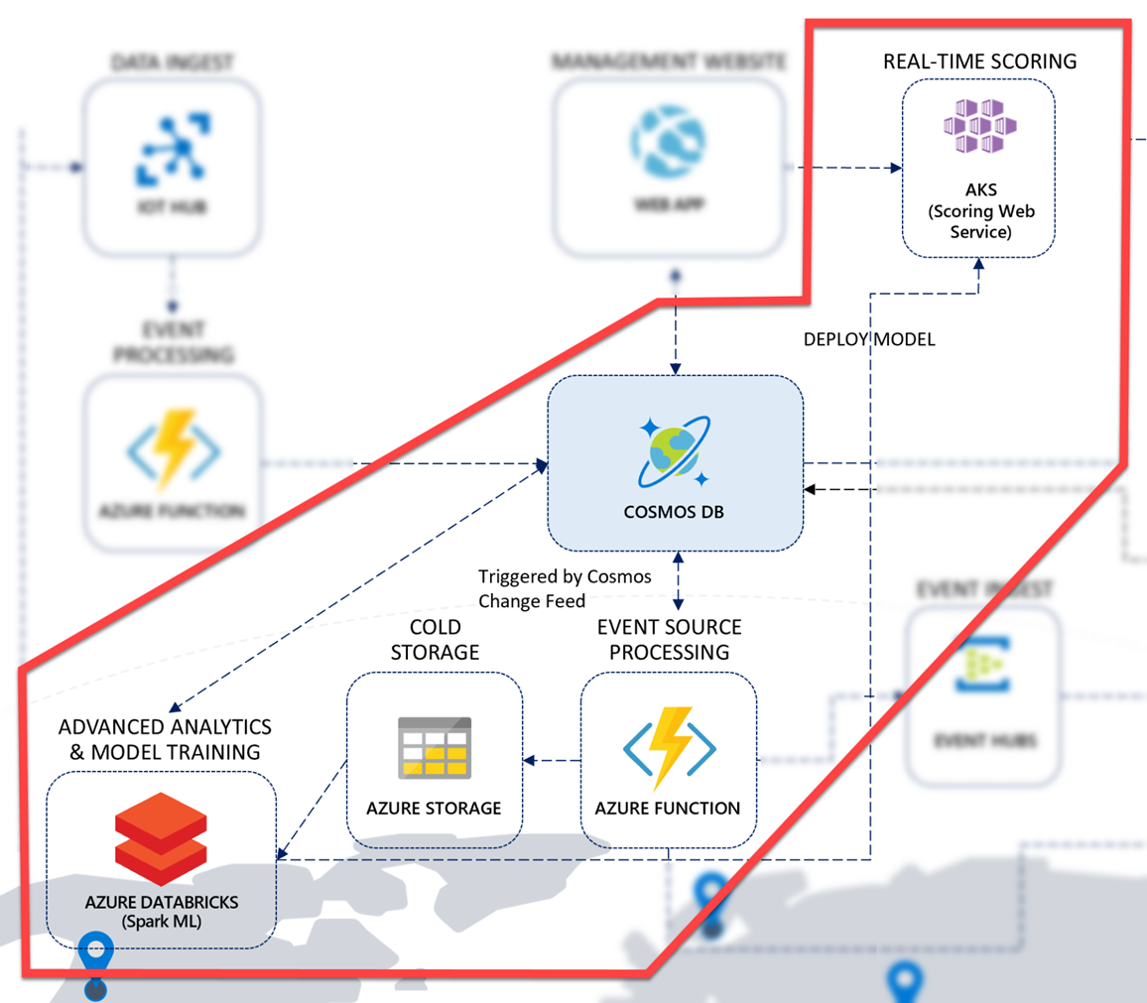
Machine Learning and advanced analytics
Azure Databricks uses an Apache Spark cluster and notebooks to train a Machine Learning model to predict battery failures
Uses the Cosmos DB Spark SDK to use vehicle trip data for model training
Uses Azure Machine Learning to deploy the model to AKS or Azure Container Instances (ACI)

Slide 125
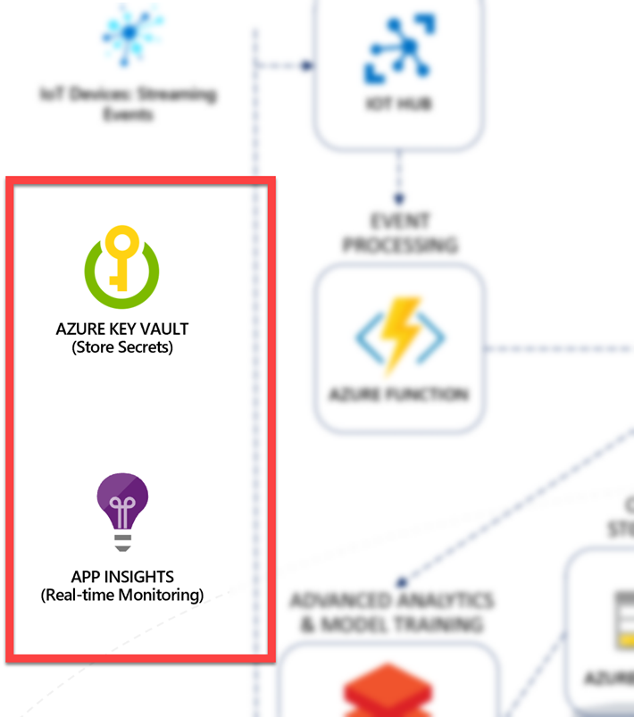
Secret storage and monitoring
Azure Key Vault securely stores secrets (such as connection strings and service keys)
The Azure Functions, Web App, and Azure Databricks services access these secrets using managed service accounts
Application Insights monitors and displays all application activity across the solution

Slide 126

Azure Key Vault
Where do we store keys and other secrets that are used by our web application, Azure Functions, and Azure Databricks?
We can’t store them with the application code.
We don’t want to store them in the application configuration.
We store them in the service designed for the purpose of managing exactly this type of secret- Azure Key Vault

Slide 127

Azure Key Vault
Azure Key Vault helps solve the following problems:
Secrets Management - Azure Key Vault can be used to Securely store and tightly control access to tokens, passwords, certificates, API keys, and other secrets.
Key Management - Azure Key Vault can also be used as a Key Management solution. Azure Key Vault makes it easy to create and control the encryption keys used to encrypt your data.
Certificate Management - Azure Key Vault is also a service that lets you easily provision, manage, and deploy public and private Secure Sockets Layer/Transport Layer Security (SSL/TLS) certificates for use with Azure and your internal connected resources.
Store secrets backed by Hardware Security Modules - The secrets and keys can be protected either by software or FIPS 140-2 Level 2 validates HSMs.

Slide 128

Application Insights
We use Application Insights to monitor live applications, including the web app and various Azure Functions.
It automatically detects performance anomalies, shows resource usage, live logs, how much time it takes for the services to receive and process data, and any errors that occur.
All that’s needed is a small instrumentation package in the application, or, in the case of our Azure Web App and Azure Function Apps, just the instrumentation key.

Slide 129
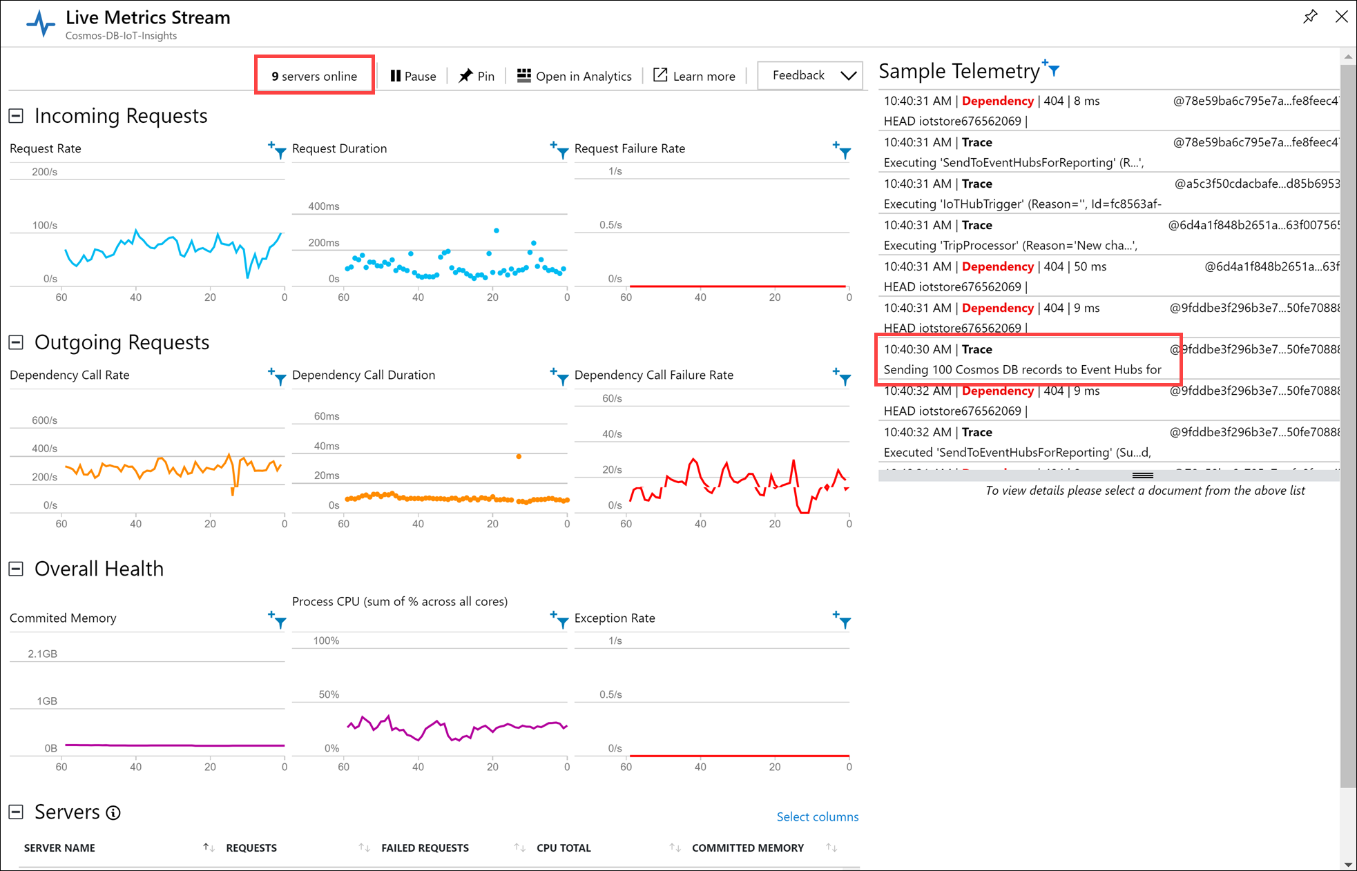
Application Insights live metrics stream

Slide 130
IoT + Manufacturing Use Cases

Slide 131


Leverage IoT Telemetry to Build Differentiated Experiences
Diverse and unpredictable IoT sensor workloads require a responsive data platform
Real-time vehicle diagnostics
Instant elastic scaling
No loss in ingestion or query performance
Azure IoT Hub
Apache Storm on Azure HDInsight
Azure Cosmos DB
(Telemetry & device state)
Azure Web Jobs (Change feed processor)
Azure Storage (archival)
Azure Cosmos DB was chosen due to its ability to ingest data at massive scale with high availability (99.99%) guarantee.
Logic apps
Notes:
Toyota’s connected-car platform collects massive volumes of sensor data in Azure Cosmos DB to deliver real-time customer service and vehicle diagnostics
Elastically scale instantly to accommodate diverse and unpredictable IoT workloads without sacrificing ingestion or query performance
Seamlessly integrates car to the digital life of customers that is safe, productive and fun.

Slide 132
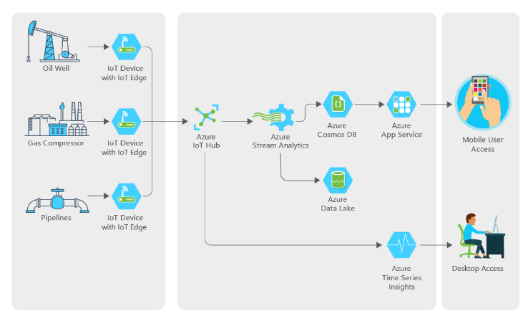

IoT, Big Data Optimize Operations at an Exxon Mobil Subsidiary
Find a better way to monitor remote wells and collect data on performance
Must be cost efficient
Unified device management and streaming
Automate IOT and analytics
“We had a team of five people working on this, and they built it from scratch. The ease of use of the Azure services and the support we got from Microsoft made that possible. .”
Notes:
Another IOT scenario is in the oil and gas industry.
XTO energy is a subsidiary of ExxonMobil, they specialize in gas production from low margin fields. Their equipment is often in extreme and remote locations with spotty connectivity which makes gathering telemetry a manual and expensive process.
Working with Microsoft we helped them design a system that would allow them a better, and cheaper way to gather this telemetry and automate much of the work behind it providing data both to uses at the home office as well as to users in the field working on the equipment.

